Slide 1
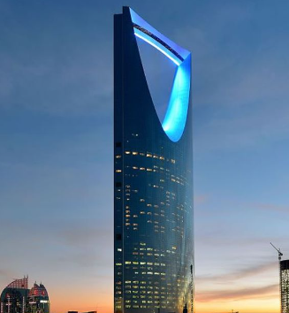
Project Documentation
Edit your logo in : View – Slide Master !!
Delete this textbox after inserting the logo
Site: Your customer name
Address and photo if applicable
Designed by: Your Company Name
Date: 10 / 2023

Slide 2
TABLE OF CONTENTS
EDIT THE HEADER ITEMS AND LINKS TO PAGES
CONTACTS AND SERVICE INFORMATION
DESCRIPTION
BLUEPRINTS AND SCHEMES
VERTICAL SCHEME
DOOR SCHEME
CONTROLLER SCHEME
COMMUNICATION RACK SCHEME
SPEED GATES CONTROL PANEL
TESTING RESULTS
IP ADDRESSES AND PASSWORDS
RECORDING CHANNELS TABLE
IP NETWORK
NVR ADDRESSES AND PASSWORDS
CONTROLLER ADDRESSES AND PASSWORDS
NETWORK SWITCHES ADDRESSES AND PASSWORDS
CAMERA ADDRESSES AND PASSWORDS
SAFETY AND INFORMATION SECURITY
DATASHEETS
CCTV DATASHEETS
CMS SOFTWARE DATASHEET
NVR DATASHEET
CAMERA DATASHEET
ACCESS CONTROL DATASHEETS
ACCESS SOFTWARE DATASHEET
CONTROLLER DATASHEET
READER DATASHEET
LOCK DATASHEET

Slide 3
PART 1 CONTACTS AND SERVICE
PROJECT MANAGER ________________________
PHONE: ___________________________________
EMAIL: ______________________________________
LEAD TECHNICIAN __________________________
PHONE : _____________________________________
EMAIL: ______________________________________
OFFICE
PHONE : _____________________________________
EMAIL: ______________________________________
SERVICE
PHONE : _____________________________________
EMAIL: ______________________________________
DATE OF PROJECT END: _______________
WARRANTY TILL THE END OF : ___MONGTH/YEAR______

Slide 4
PART 2 DESCRIPTION
The main target of this project is implementing security systems in the office building and maintaining safety on the premises via:
CCTV System
CCTV cameras have been installed in all public premises in order to prevent crime and maintain safety.
The recorded information is stored for 30 days and accessible from a dedicated work station in the managers office.
Live view of the cameras is accessible from the lobby concierge work station.
ACCESS CONTROL
All lobby entry doors and technical rooms doors are equipped by digital locks securing the premises and preventing access from unauthorized individuals.
Authorized access is perfomed via personal cards and calling the concierge by the intercoms
Please edit this text to match your project systems and equipment

Slide 5
PART 3 BLUEPRINTS AND SCHEMES 3.1 VERTICAL SCHEME
CAN BE SCHETCHED IN VISIO OR ANOTHER SIMILAR EDITOR

Slide 6
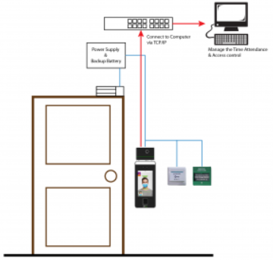
3.2 DOOR SCHEME
USUALLY CAN BE FOUND IN PROJECT DESCRIPTION OR FROM A CONSULTANT SPECIFICATIONS
IF NOT APPLICABLE, CAN BE SCHETCHED IN VISIO OR ANOTHER SIMILAR EDITOR

Slide 7
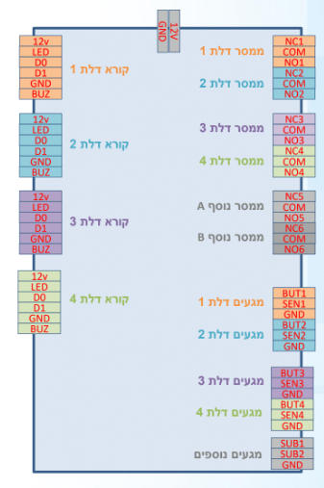
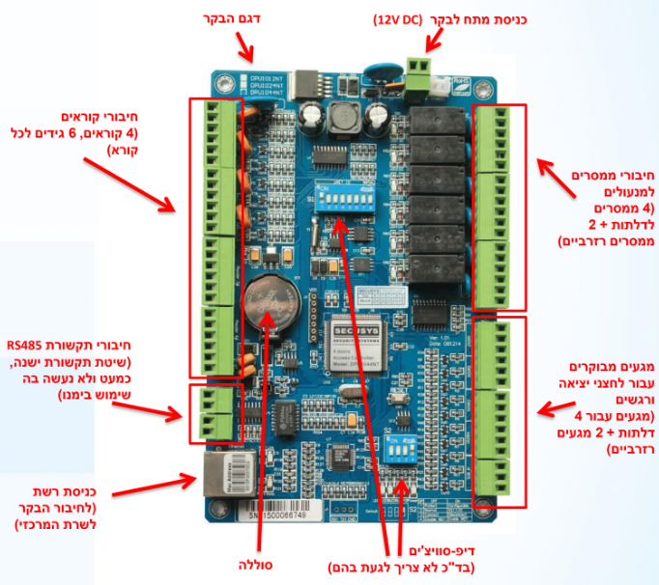
3.3 CONTROLLER SCHEME
USUALLY CAN BE DOWNLOADED FROM THE TECHNICAL SHEETS OF EQUIPMENT ON MANUFACTURERS WEBSITE

Slide 8
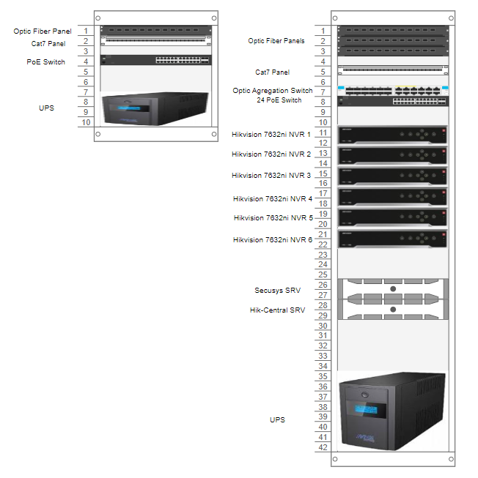
3.4 COMMUNICATION RACK SCHEME
TYPICAL RACK MAIN CORE RACK
USUALLY DONE IN MICROSOFT VISIO OR ANY OTHER SCHEME EDITOR .
I RECOMMEND DRAW.IO SOFTWARE

Slide 9
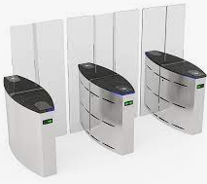
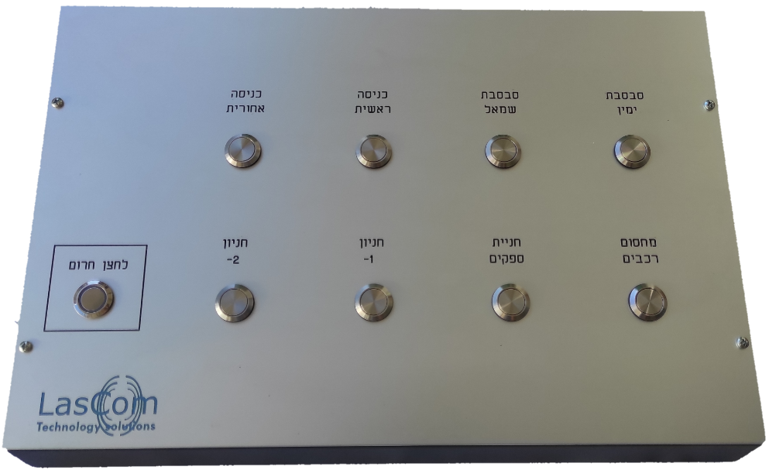
3.5 SPEED GATES
SAMPLE SPEED GATES IN THE PROJECT
SAMPLE ENTRY PANEL

Slide 10
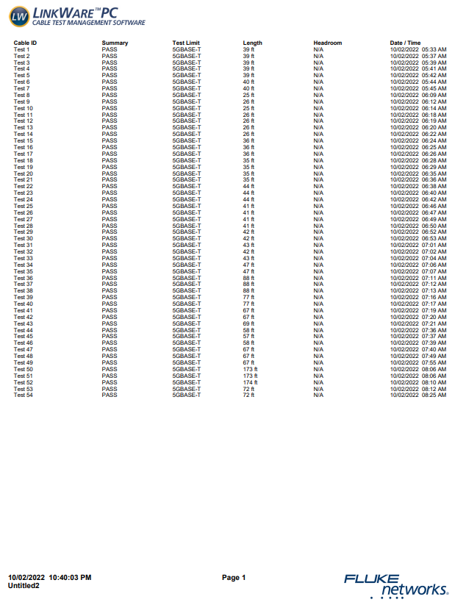
4. TESTING RESULTS

Slide 11
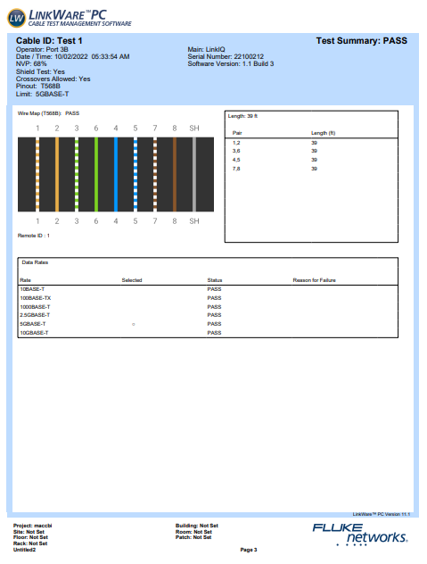

Slide 12
PART 5 NETWORK ADDRESS TABLES 5.1 RECORDING CHANNELS
NVR | NVR 01 | NVR 02 | NVR 03 | TOTAL
FLOOR
-2 | - | - | 3 | 3
-1 | 3 | 3 | 3 | 9
G | 2 | 2 | 2 | 6
1 | 2 | 2 | 3 | 7
2 | 1 | 1 | 2 | 4
3 | 3 | - | - | 3
4 | 3 | - | - | 3
5 | 3 | - | - | 3
6 | 3 | - | - | 3
7 | 3 | - | - | 3
8 | 3 | - | - | 3
9 | - | 3 | - | 3
10 | - | 3 | - | 3
11 | - | 3 | - | 3
TOTAL | 26 | 17 | 13 | 56

Slide 13
PART 5.2 NETWORK ADDRESS
IP NETWORK | 172.20.0.0/18
SUBNET MASK | 255.255.192.0
GATEWAY | 172.20.63.254
PART 5.3 NVR ADDRESS TABLE
NVR | IP | MAC | USER | PASS
HIK-SRV | 172.20.60.100
HIK-CLNT | 172.20.60.101
NVR01 | 172.20.60.1 |  | admin
NVR02 | 172.20.60.2 |  | admin
NVR03 | 172.20.60.3 |  | admin
PART 5.4 CONTROLLER ADDRESS TABLE
SECUSYS | IP | MAC | USER | PASS
SEC-SRV | 172.20.60.50
SEC01 | 172.20.60.51 |  | admin
SEC02 | 172.20.60.52 |  | admin
SEC03 | 172.20.60.53 |  | admin
SEC04 | 172.20.60.54 |  | admin
SEC05 | 172.20.60.55 |  | admin
SEC06 | 172.20.60.56 |  | admin
SEC07 | 172.20.60.57 |  | admin
SEC08 | 172.20.60.58 |  | admin
RISCO | 172.20.60.70
SEC-CLNT | 172.20.60.80
PART 5.5 NETWORK SWITCHES
FL8 | 172.20.61.8 | admin
FL3 | 172.20.61.3 | admin
FL-1 | 172.20.61.51 | admin
FL-2 | 172.20.61.52 | admin
FL-3 | 172.20.61.53 | admin
FL-3-CORE | 172.20.61.54 | admin
FL-5 | 172.20.61.55 | admin

Slide 14
5.6 CAMERA ADDRESS TABLE
CAMS | IP | MAC | USER | PASS
FL17 | 172.20.17.001 - 003 |  | admin
FL16 | 172.20.16.001 - 003 |  | admin
FL15 | 172.20.15.001 - 003 |  | admin
FL14 | 172.20.14.001 - 003 |  | admin
FL13 | 172.20.13.001 - 003 |  | admin
FL12 | 172.20.12.001 - 003 |  | admin
FL11 | 172.20.11.001 - 003 |  | admin
FL10 | 172.20.10.001 - 003 |  | admin
FL9 | 172.20.09.001 - 003 |  | admin
FL8 | 172.20.08.001 - 003 |  | admin
FL7 | 172.20.07.001 - 003 |  | admin
FL6 | 172.20.06.001 - 003 |  | admin
FL5 | 172.20.05.001 - 003 |  | admin
FL4 | 172.20.04.001 - 003 |  | admin
FL3 | 172.20.03.001 - 003 |  | admin
FL2 | 172.20.02.001 - 004 |  | admin
FL0 | 172.20.00.001 - 019 |  | admin
FL-1 | 172.20.51.001 - 010 |  | admin
FL-2 | 172.20.52.001 - 010 |  | admin
FL-3 | 172.20.53.001 - 010 |  | admin

Slide 15
PART 6 SAFETY INSTRUCTIONS
Do not disconnect or connect a component of the system that is not by the hands of our authorised technician
If there is a malfunction or damage such as exposed wires or a disassembled accessory, do not touch the wiring or the accessory and immediately open a service call
Do not connect a foreign network component to the security network. The security network is a network in a closed circuit.
It is strictly forbidden to connect an external accessory or an external communication cable
Do not connect a media component such as a foreign USB disk to the security computers
Connecting foreign media can lead to breaching of the security system and heavy fines will apply to those who violate this instruction
Passwords, as well as any details of the security components, must not be given to a third party, including the amount and deployment of the means, the type of means, the work procedures and any other details
Do not make any changes to the layout of the security network except by our authorized technician

Slide 16
PART 7 DATASHEETS 7.1.1 CCTV VMS SOFTWARE

Slide 17
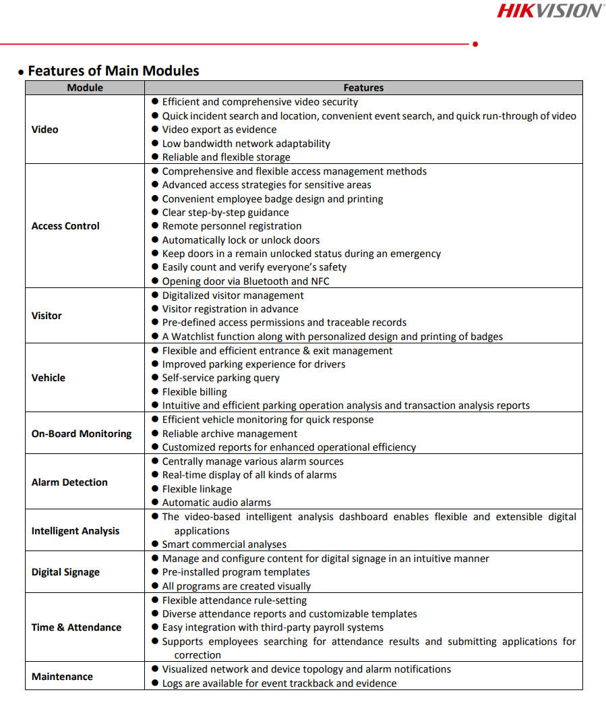
7.1.1 CCTV VMS SOFTWARE

Slide 18
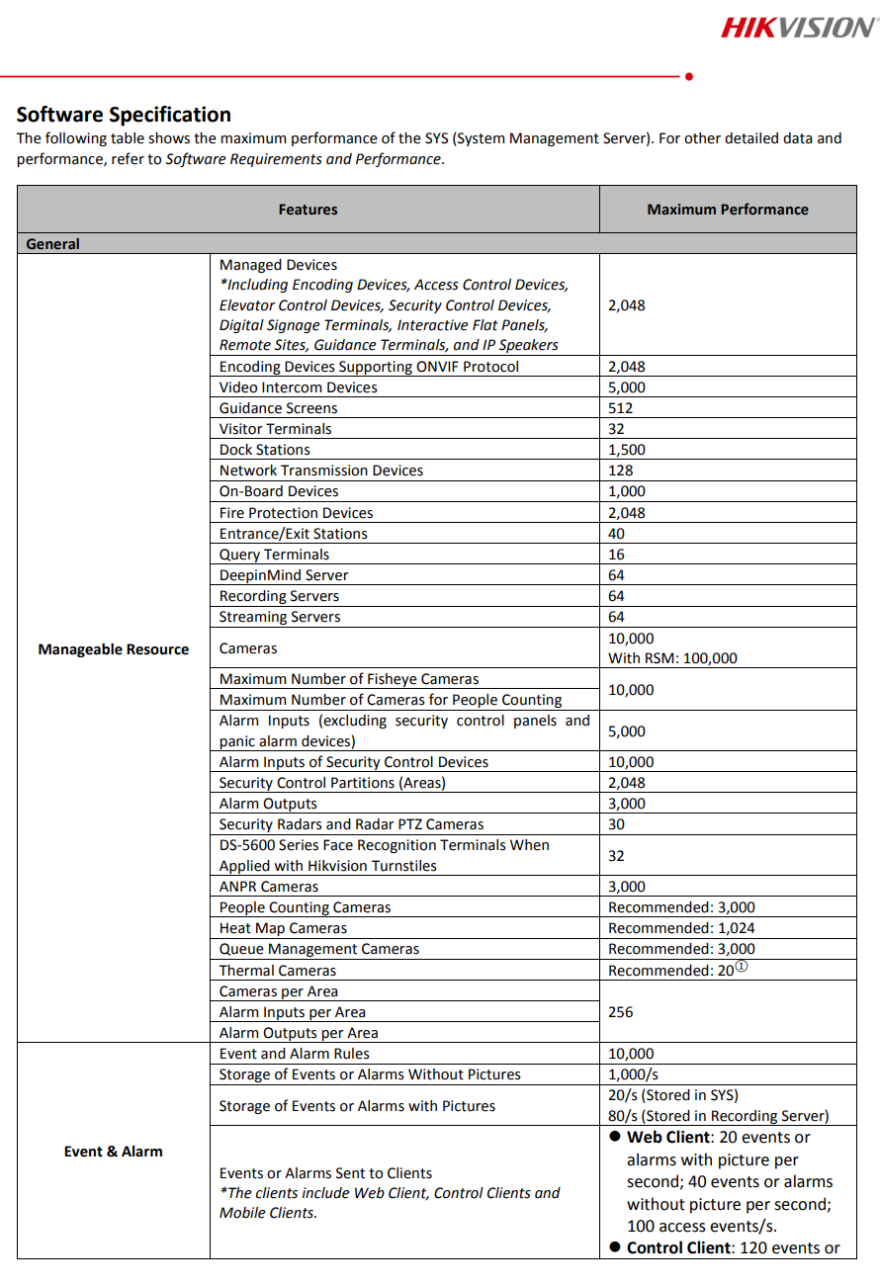
7.1.1 CCTV VMS SOFTWARE

Slide 19
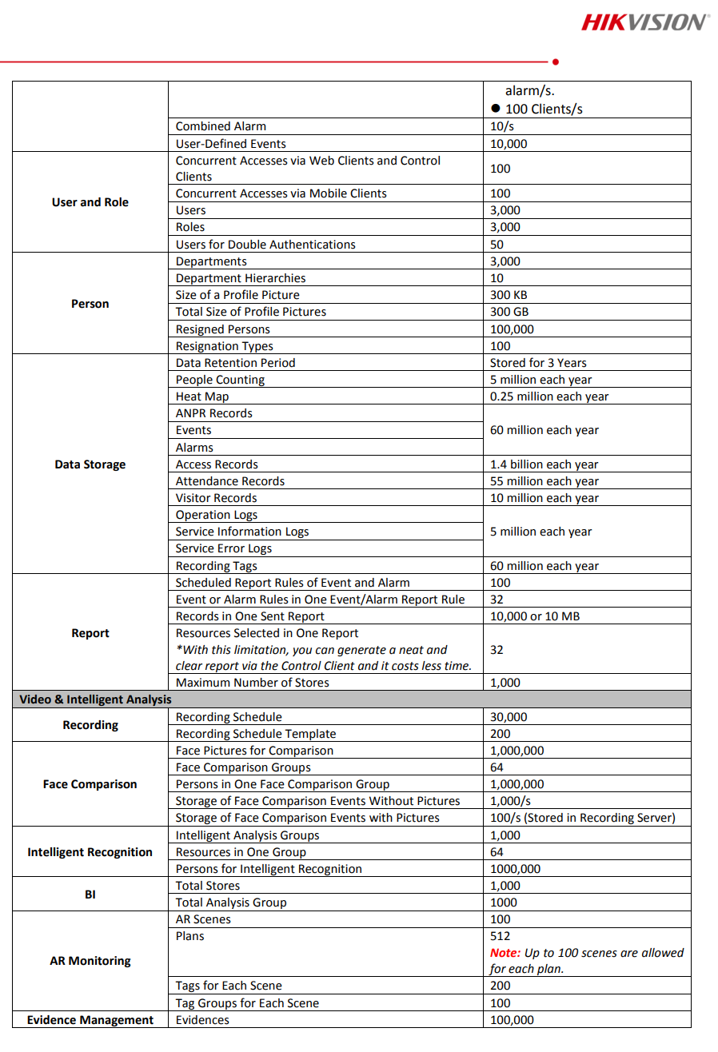
7.1.1 CCTV VMS SOFTWARE

Slide 20
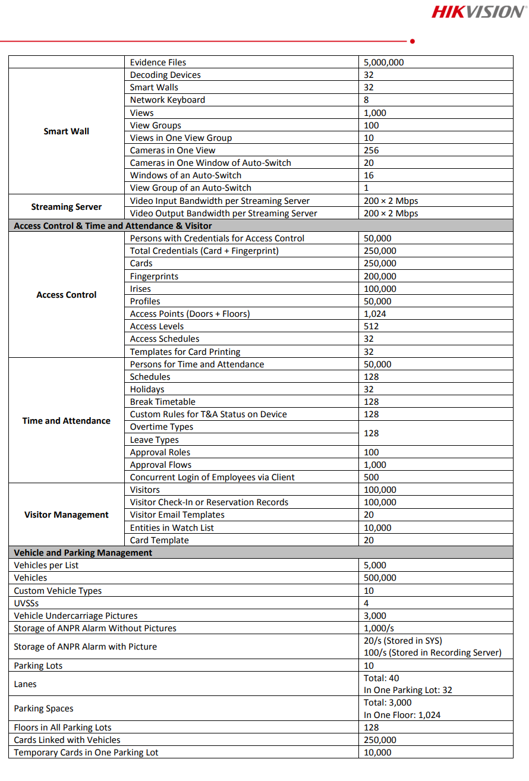
7.1.1 CCTV VMS SOFTWARE

Slide 21
7.1.2 NVR DATASHEET

Slide 22
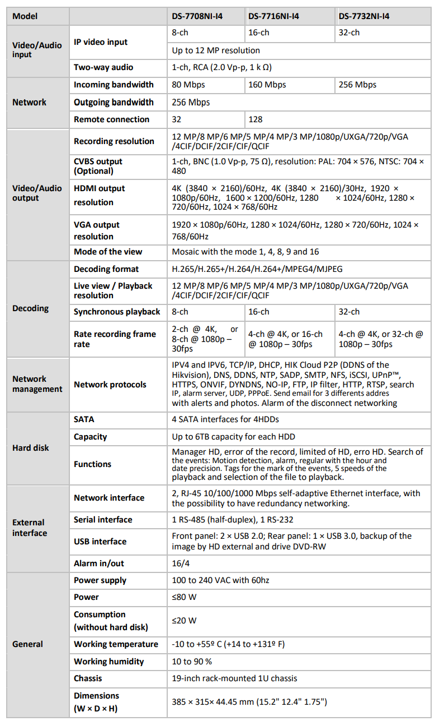
7.1.2 NVR DATASHEET

Slide 23
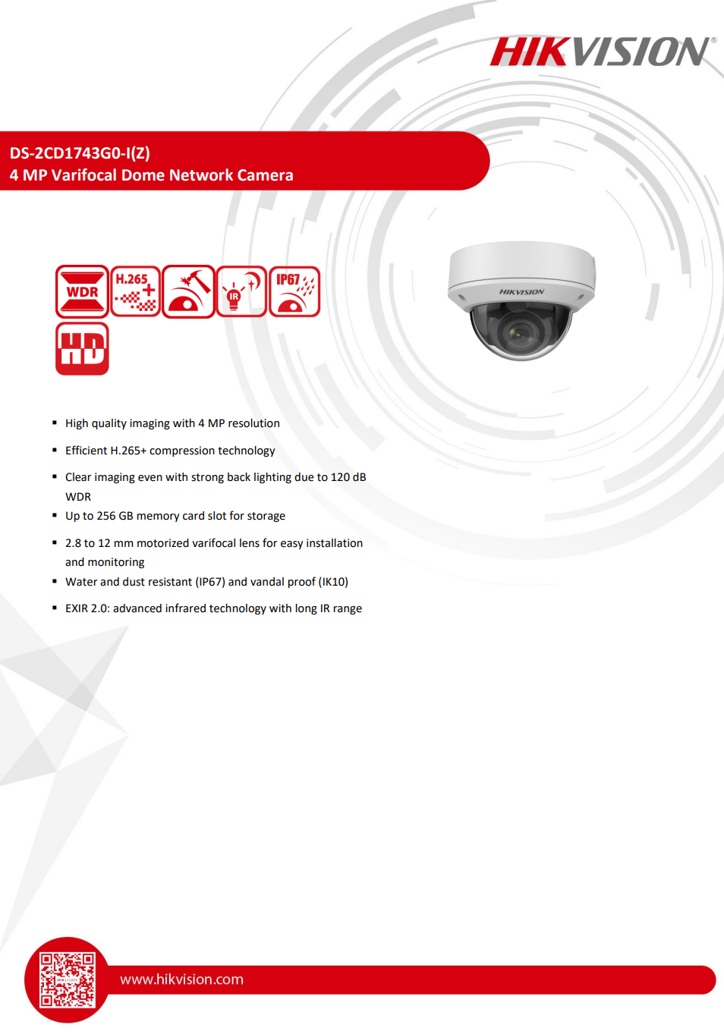
7.1.3 CAMERA DATASHEET

Slide 24
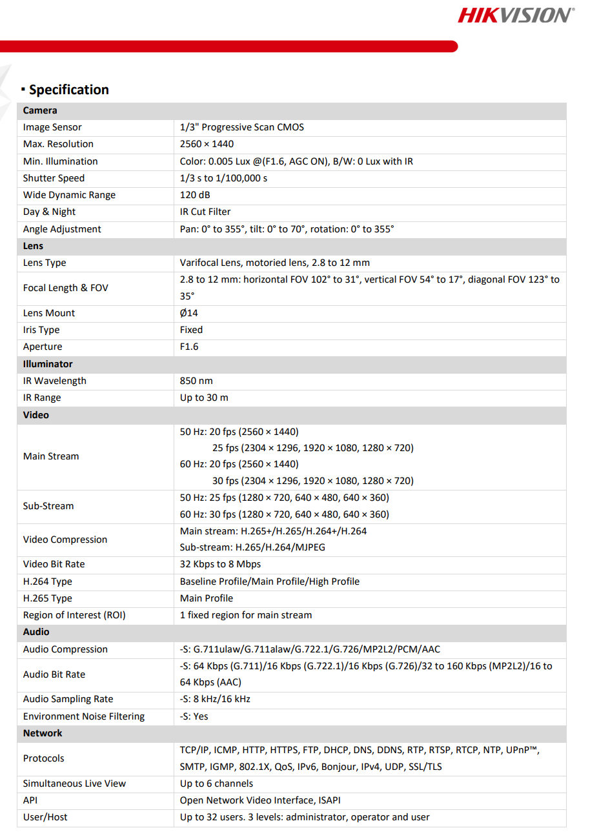
7.1.3 CAMERA DATASHEET

Slide 25
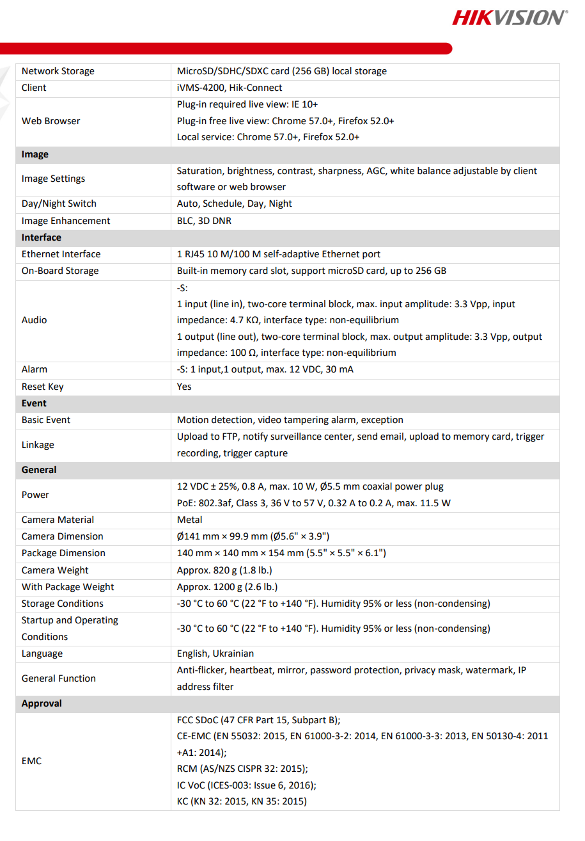
7.1.3 CAMERA DATASHEET

Slide 26
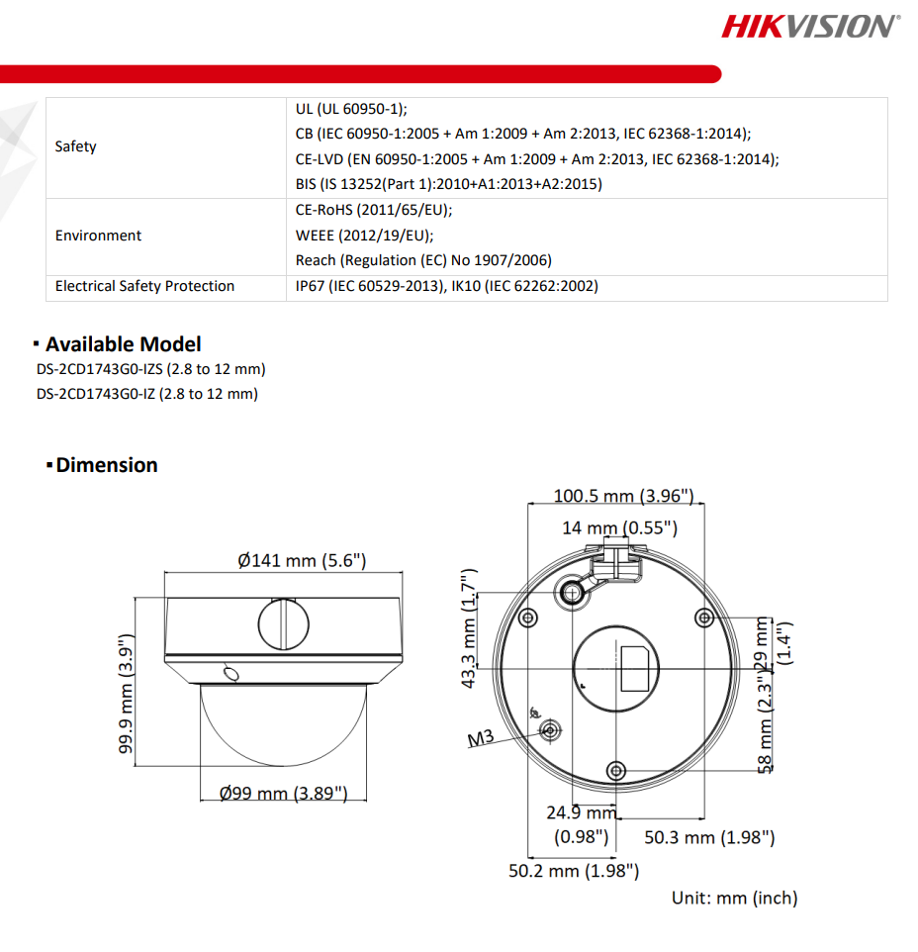
7.1.3 CAMERA DATASHEET

Slide 27
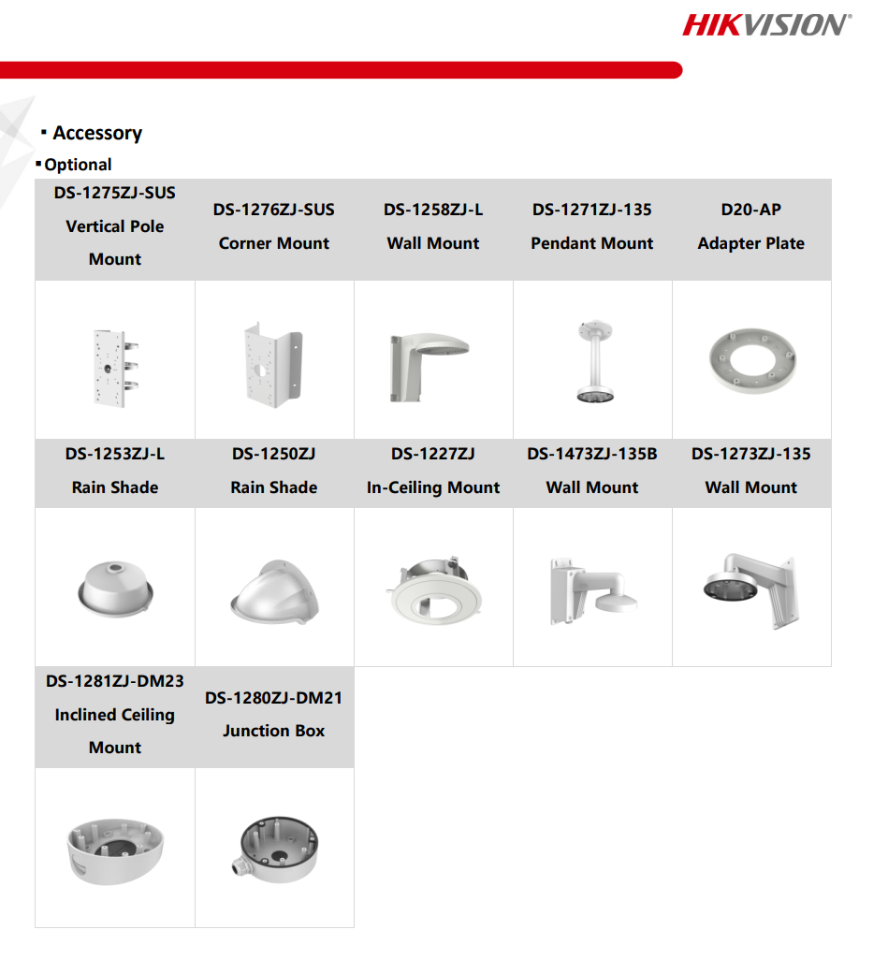
7.1.3 CAMERA DATASHEET

Slide 28
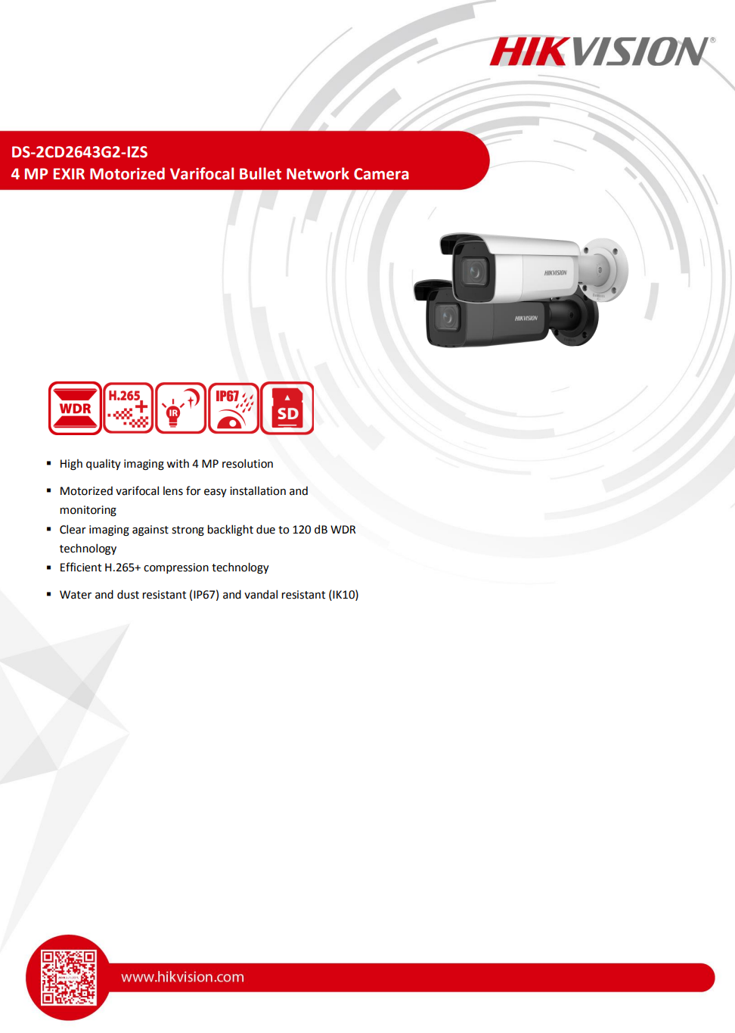
7.1.3 CAMERA DATASHEET

Slide 29
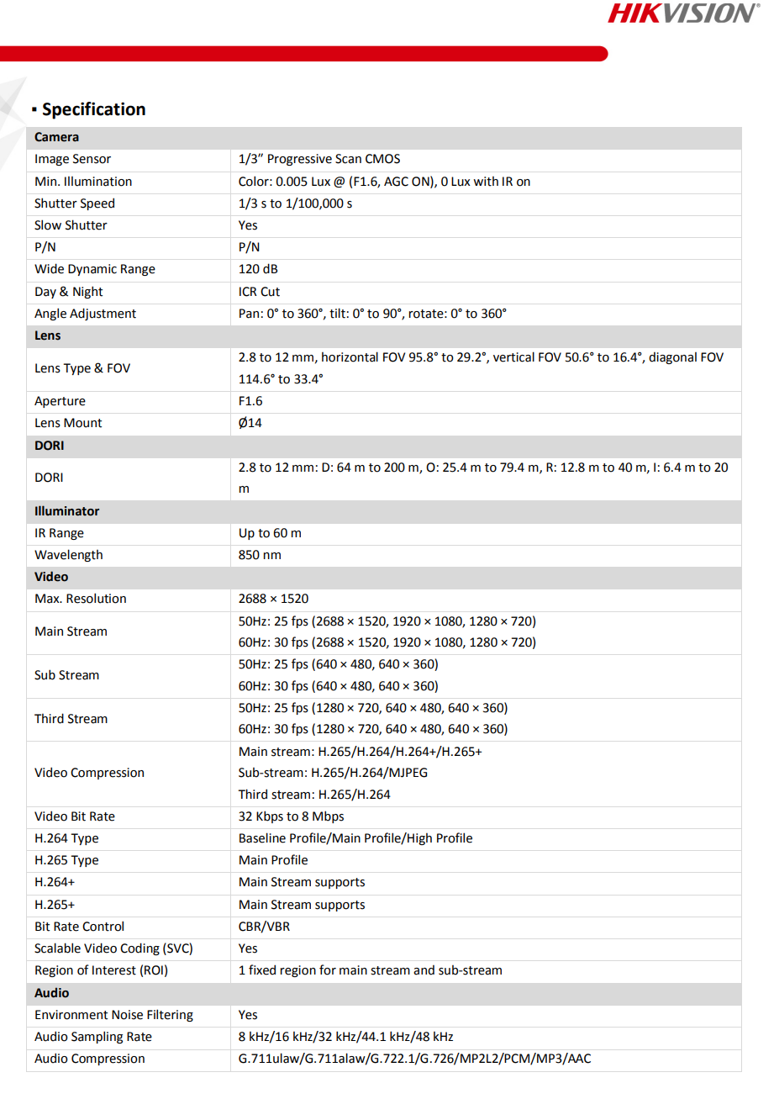
7.1.3 CAMERA DATASHEET

Slide 30
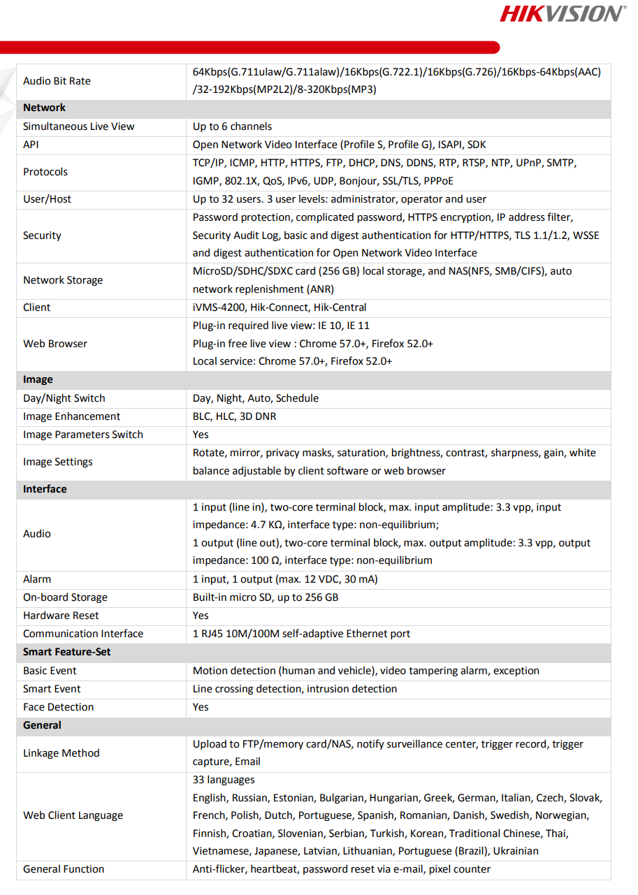
7.1.3 CAMERA DATASHEET

Slide 31
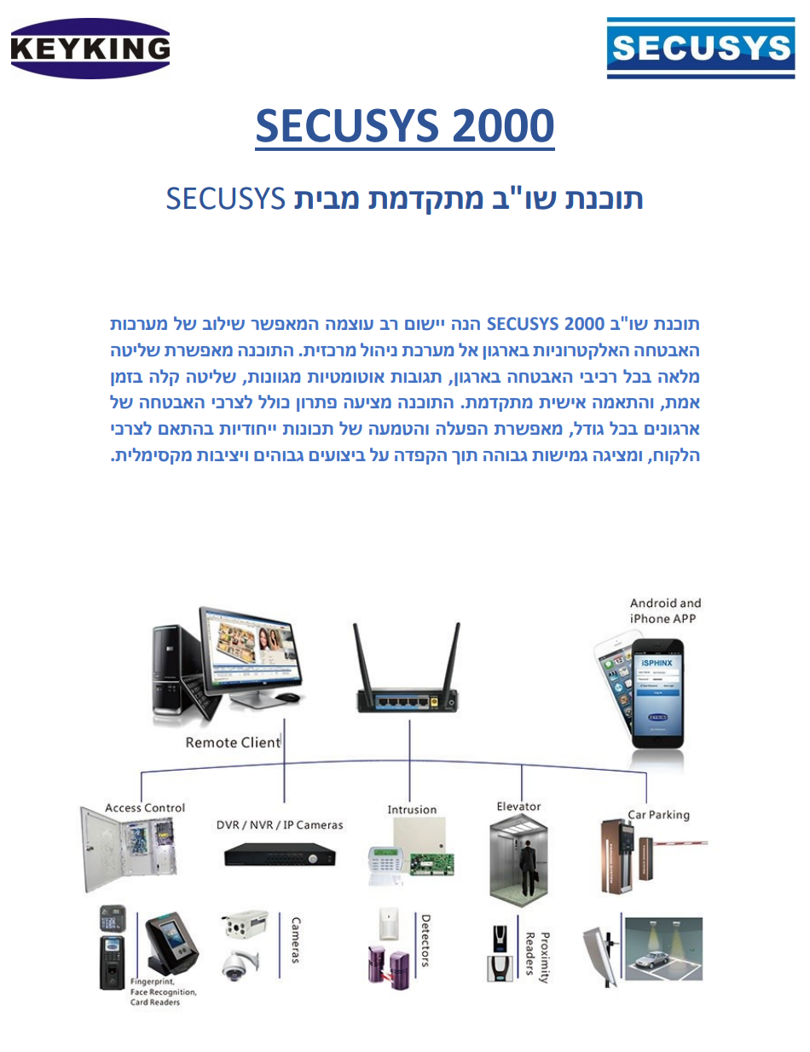
7.2.1 ACCESS CONTROL

Slide 32
7.2.1 ACCESS CONTROL

Slide 33
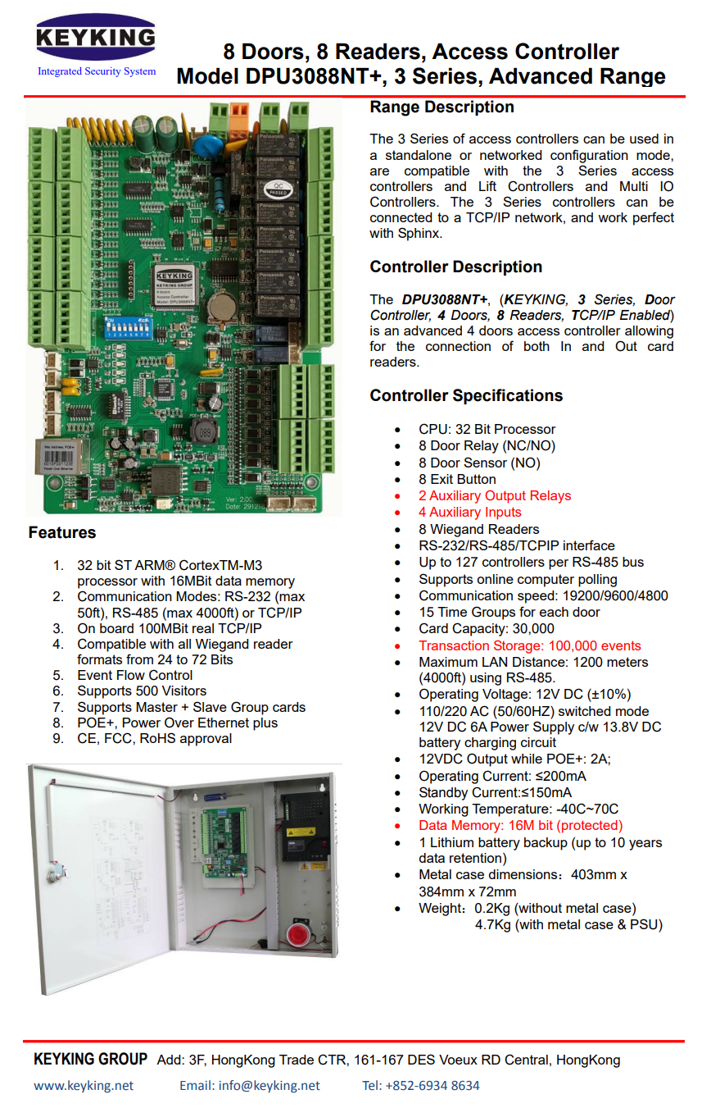
7.2.2 ACCESS CONTROLLER

Slide 34
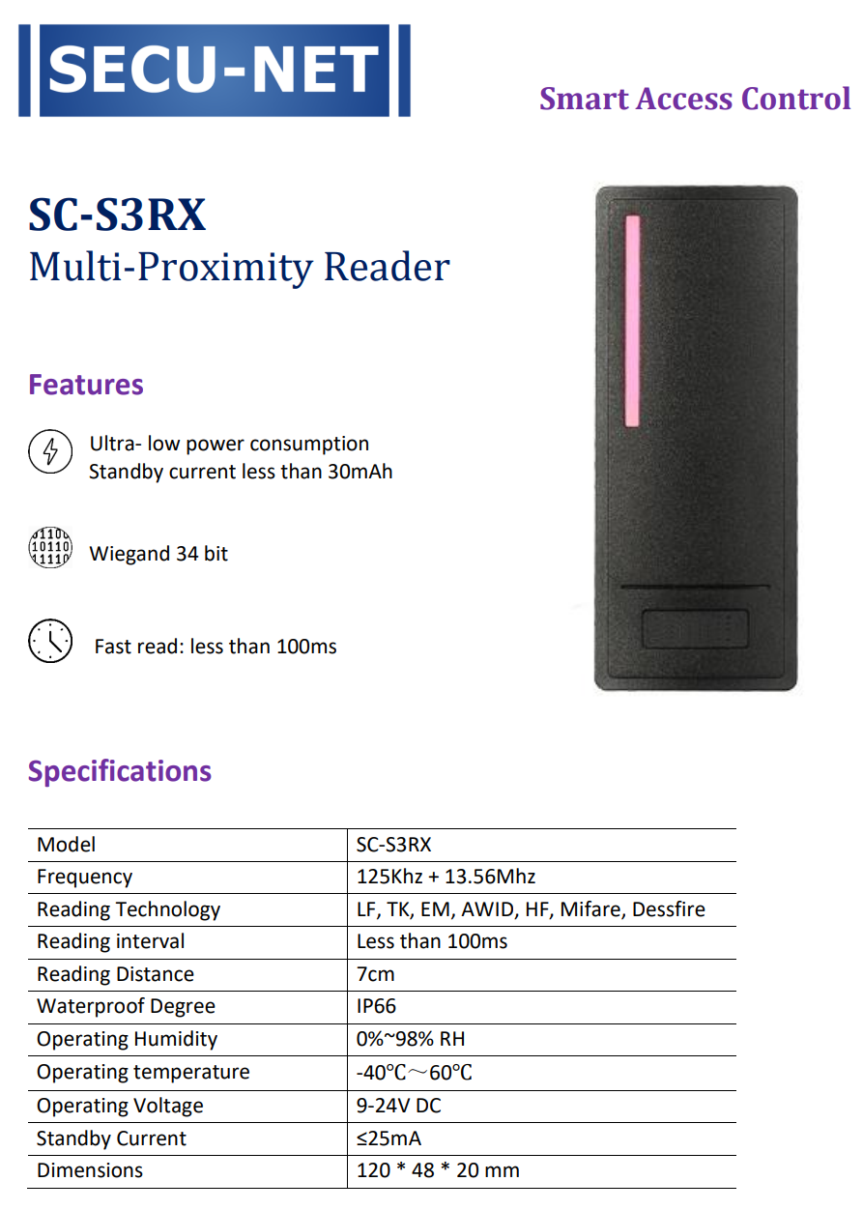
7.2.3 ACCESS READER

Slide 35
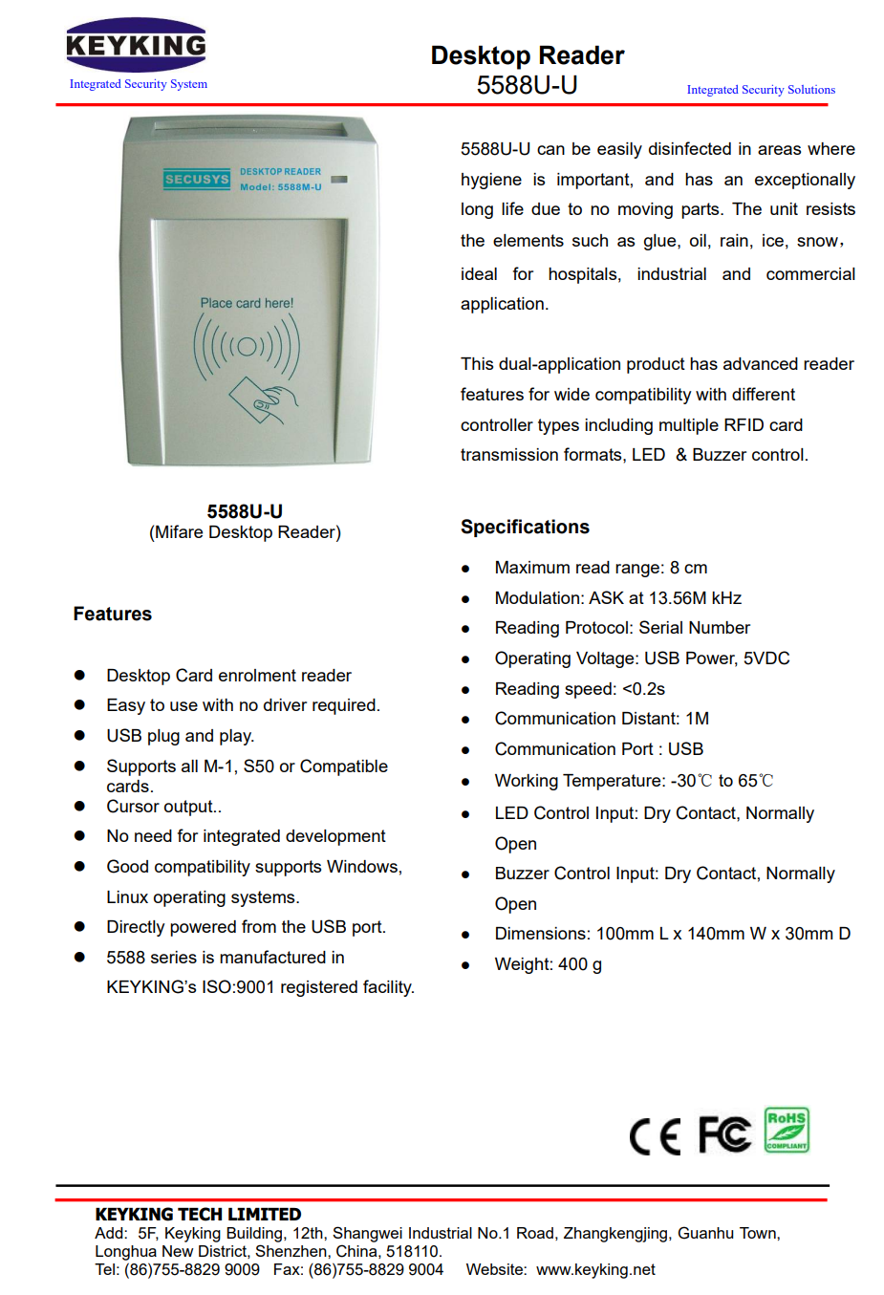
7.2.3 ACCESS READER

Slide 36
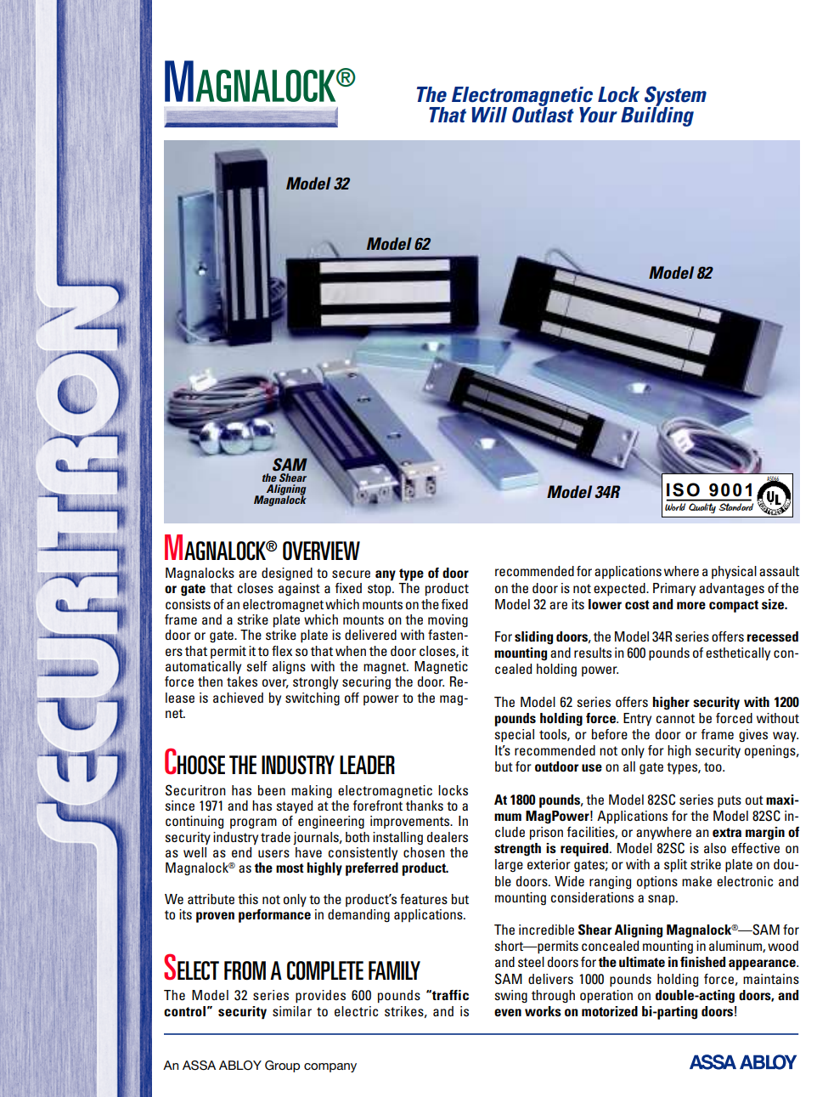
7.2.4 ELECTROMAGNETIC LOCK

Slide 37
7.2.4 ELECTROMAGNETIC LOCK

